Slide 1
Tutorial #2: Javascript
Aashik Azim

Slide 2
Summary of Tutorial #1: HTML and CSS
HTML for presenting structure of a webpage
CSS for presenting contents
Web browsers for interpreting and rendering web pages
Separation of presentation and content

Slide 3
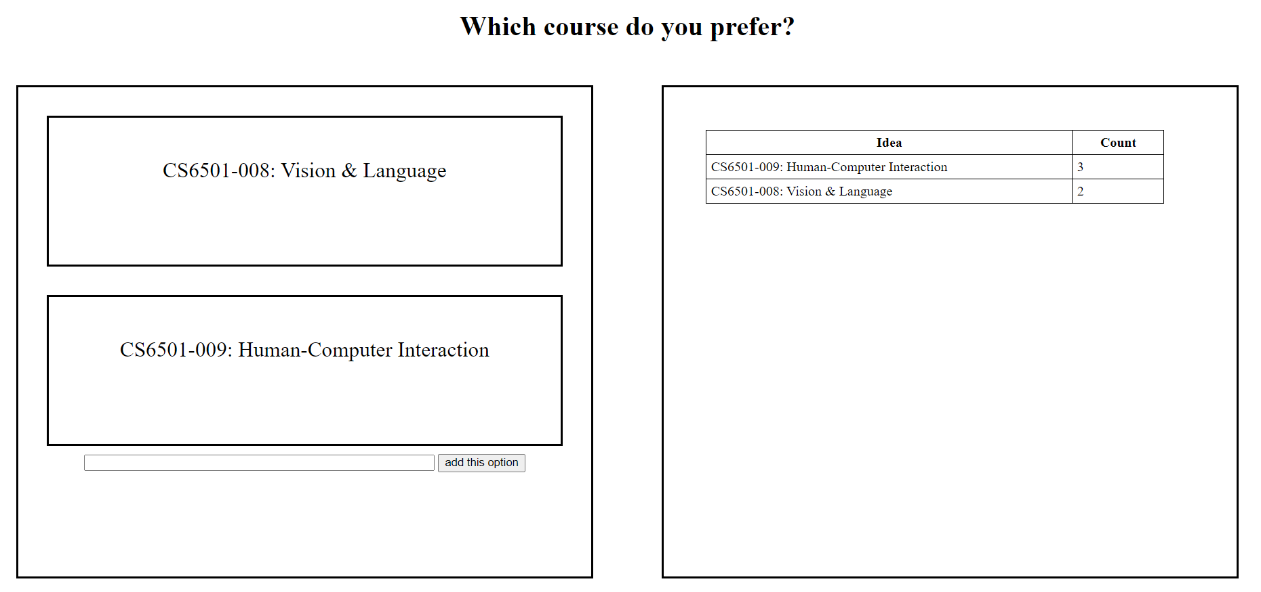
Learning Objective
Student will be able to build an interactive course selection system as follows:
Goal: Construct following website – hands-on

Slide 4
Learning Objective
Which action should we implement?
Hover

Slide 5
Learning Objective
Which action should we implement?
Hover
Click and counting

Slide 6
Learning Objective
Which action should we implement?
Hover
Click and counting
Add an option

Slide 7
Learning Objective
Which action should we implement?
Hover
Click and counting
Add an option
Sorting
Presenting on the table

Slide 8
Learning Objective
Which action should we implement?
Hover
Click and counting
Add an option
Sorting
Presenting on the table

Slide 9
Event
Events happen whenever interactive things take place
Click/mouse movement
Typing keyboard
User-generated event
Example: Raise and alert when a user clicks a button

Slide 10
Algorithm
1. When user clicks an option
2. Increase the count of that option
3. Sort the result
4. Refresh the result
5. Refresh the options

Slide 11
Algorithm
1. When user clicks “add an option”
2. Add an option with count 1
3. Clear the input box
4. Refresh the result
5. Refresh the options

Slide 12
Summary of Algorithm
1. When user clicks “add an option”
1. When user clicks an option
2. Increase the count of that option
2. Add an option with count 1
3. Sort the result
3. Clear the input box
4. Refresh the result
4. Refresh the result
5. Refresh the options
5. Refresh the options

Slide 13

Javascript basic concepts
Variables:
JavaScript variables can hold numbers and text values
Strings are written inside double or single quotes.
Numbers are written without quotes.
Examples:

Slide 14

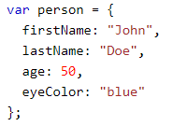
Javascript basic concepts – Data Types
Primitive Data Types:
Numbers
Strings
Boolean (True, False)
Composite Data Types
Arrays
Objects

Slide 15
Javascript basic concepts – Operators
+ Addition
Subtraction
* Multiplication
/ Division
% Modulus
++ Increment
- - Decrement
== Equality
!= Inequality
! Logical NOT
&& Logical AND
|| Logical OR
? Conditional Selection

Slide 16
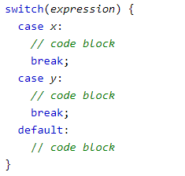
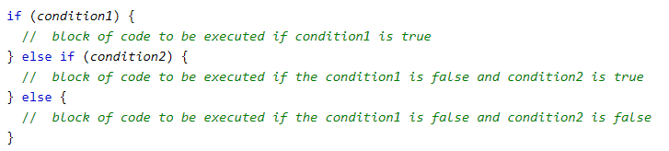
Javascript basic concepts – Control Flow
Switch statement
If-Else statement

Slide 17




Javascript basic concepts – Looping
For loop statement
While loop statement

Slide 18


Javascript basic concepts – Functions

Slide 19
Demo Let’s Implement it
Write the code after me on visual code:
Use the provided HTML & CSS templates
Just implement algorithm in script.js file

Slide 20
Summary of Javascript
A language to make a website do something
DOM provides the way to access HTML elements
An HTML element us handled as an object in javascript
YOU DON’T NEED TO MEMORIZE JS libraries
Google it whenever you want to do something
More on: https://www.w3schools.com/js/default.asp

Slide 21
Next day: Tutorial #3 Working with Data
Why?
Our application should be available on any client
We have to store ‘state’ of our web application
Topics will be covered:
Firebase Database
How to store data in Firebase Database
How to retrieve data from Firebase and update UI

Slide 22
Thank You!
Questions?

